Slide 1
Interpolation, the rudimentary geometry of spaces of Lipschitz functions, and complexity
Shmuel Weinberger
University of Chicago

Slide 2
An Analogy
Function theory Manifold theory
Lipschitz functions Well conditioned manifolds
Interpolation Topological
inference

Slide 3
Analogy (continued)
Function theory Manifold theory
Quantitative equicontinuity LC(ρ)
(e.g. Holder)
Function spaces Gromov- Hausdorff space

Slide 4
Motivation
Function theory:
Almost all of mathematics studies functions and often via function spaces.
We wish to increase the geometric aspect of this study – which therefore suggests considering geometric analogues.
Also, we are interested in nonlinear function spaces (e.g. when the target is not a linear space), which have geometry.

Slide 5
Motivation
Manifold theory
Pattern recognition, stable geometric signatures for machine learning, vision, data analysis, etc.
A source of sophisticated techniques that can be useful in nonlinear settings.
Shed light on interactions between topology and metric geometry.

Slide 6
Pontilism

Slide 7
The envelope problem
Given several function values, what is a function?
Given a lattice in a Lie group, what Lie group does it come from. i.e. given the fundamental group of a hyperbolic n-manifold, how do we discover O(n,1)? (the group of isometries of hyperbolic space).

Slide 8
The envelope problem
Given samples from a manifold (or a more general space), infer the space.
In all cases, one tries not to require too small a scale, but then has to make some small scale assumptions on the envelope to make the question reasonable (well posed).

Slide 9
Outline of the talk
Interpolation for functions and its analogue for spaces: Rips and Persistent homology.
Application to function spaces: existence of contractible geodesics.
Simply connected targets: A speculation.
Why that’s not enough.
Entropy (volume) of function spaces
Diameter of components

Slide 10
Outline of the talk
7. Applications:
Navigation in function spaces?
Resources necessary when solving distributed computing tasks?
Quantitative nullcobordism.
8. Back to Gromov-Hausdorff space and multiscale reconstruction.

Slide 11
Envelopes in Lie Groups
Z
Z²
Z³
Heisenberg group of upper triangular integer 3x3 matrices

Slide 12
Heisenberg

Slide 13
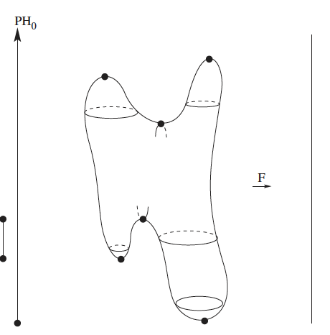

Slide 16
Persistent Homology
Several stability properties:
Long bars.
LC^{k} is enough for dimension ≤k
Lots of short bars, stable w.r.t. smooth perturbations.

Slide 17
Persistent Homology for points sampled from a torus

Slide 18
Persistent Homology
Definition
Several stability properties:
Long bars.
LC^{k} is enough for dimension ≤k
Lots of short bars, stable w.r.t. smooth perturbations.
Examples:
Long bars compute the homology of a space from a sufficiently dense sample
Brownian motion on [0,1]: the number PH₀ bars of length around l grows like 1/l³.

Slide 20
Properties of Linear function spaces
Interpolation formulae
By convex optimization (or sometimes explicit formula)
Entropy of the function space.
Exp(L^{d}) where d = dim(X)
Diameter is bounded (if the target is compact)
As is obvious from a straight line homotopy.

Slide 21
If the target is S¹
If the target = S¹ (or nonpositively curved):
One still gets homotopies that don’t increase the Lipschitz constant
However one has linear bound on diameter.

Slide 22
Maps (S¹: M)
Serre’s theorem on geodesics: Every closed manifold has infinitely many geodesics connecting each pair of points. (algebraic topology)
What about closed geodesics?
Convenient to study this via PH(log E) on the function space Maps(S¹: M)

Slide 23
What do we learn?
There can only be exponentially many “deep geodesics” of any finite depth. (=Entropy)
If the Dehn function is superexponential, then infinitely many closed nullhomotopic geodesics.
An example of a group where PH has long bars.
<x,y,t | xyx⁻¹ = y² and [y,t] = e >
Note that the short curve [x^{n}yx^{-n}, t] represents the trivial element, but it involves exponentially many uses of the relations.

Slide 24
For a 3-dimensional Sol manifold, there is an exponential Dehn function, but no closed nullhomotopic geodesics.
This reflects the diameter of that component of Map(S¹: M) with Length < L is actually exp(L).
Note that entropy bounds diameter.

Slide 25
Moral: π₁ makes life difficult.
And, of course, this was known already to the algebraic topologists:
Brown’s theorem asserts the calculability of π_{i}(X) if X is a simply connected finite complex.
Our aim is related to but not exactly making Brown’s theorem reasonable.

Slide 26
What if the target is simply connected but perhaps has positive curvature?
Theorem (Ferry-Weinberger) The following are equivalent for a finite complex Y:
There is a C(n) so that for any X (with a standardized local metric) of dimension n, two L-lipschitz maps X → Y that are homotopic are C(n)L-lipschitz homotopic
All of the homotopy groups of Y are finite.
Addendum (Chambers-Dotterer-Manin-Weinberger): In this case, there is a uniform bound on the diameter of space of L-lipschitz maps independent of dim(X) and L. (Like the bounded convex situation)
Naively, this would seem to be ok if one had linearly bounded diameter.

Slide 27
Applications
Navigation in function spaces.
In theory L-lip(X: Y) you locally can understand “linearly” via an exponential map up to a scale of the injectivity radius of Y.
However, you should not have to use more than a finite number of such charts in describing a homotopy algorithm.

Slide 28
Applications
Wherever algebraicization is a major tool.
Defects of algebraicization:
Free lunch (= versus ≈ )
Descending sequences of finite sets and ascending union of subsets of a finite set terminate.
Algebraic topology decomposes spaces into “algebraically simpler” but infinite dimensional objects.

Slide 29
Applications
Resources necessary when solving distributed computing tasks.
In the theory of Herlihy and collaborators, problems of distributed computation are reduced to homotopy theory. These reductions only measure the complications caused by information and communication. To encode

Slide 30
Distributed computation a la Herlihy et al
In this theory, problems become encoded as extension problems for functions from an “input space” to an “output space”.
Solvability implies that the original problem is not blocked by problems of communication and information.
But it does not take into account resource bounds of the individual nodes. This requires Lipschitz algebraic topology.

Slide 31
Application
Unoriented cobordism (Chambers-Dotterer-Manin-Weinberger). If M^{n} is the boundary of a compact manifold W (with uniformly locally bounded geometry) then it also bounds a V, where the vol(V) is bounded by some polynomial p_{n}(V).
Proof: Combine with the ideas of R.Thom.

Slide 32
What if the target has some rational homotopy?
In general, we don’t know. Although, obviously there are obstructions.
There are examples, where even for a fixed X (=S^{n}) there are no linear bounds for the size of nullhomotopies.

Slide 33
When Y = S^{n} n odd
Example R^{n} → T^{n} → S^{n} can’t be “Lipschitz nullhomotoped”
H^{n} → S^{n} can be Lipschitz nullhomotoped using a Ponzi scheme (or the linear isoperimetric inequality).

Slide 34
Theorem (CDMW) If Y has the rational homotopy of a product of odd dimensional spheres, then for any finite complex X, the homotopic L-lipschitz maps are C_{X}L homotopic,
And diam L-Lip(X: Y) grows linearly in L.

Slide 35
Application
As before, but now can also handle oriented nullcobordism.
Theorem (CDMW) If M^{n} is the boundary of a compact oriented manifold W (with uniformly locally bounded geometry) then it also bounds such a V, where the vol(V) is bounded by some polynomial p_{n}(V).

Slide 36
Finiteness Theorems in Riemannian Geometry
Theorem (Cheeger) The number of n manifolds with |K| ≤ 1 and vol >c>0 can be bounded in terms of volume.
Key moment in proof: turning the lower bound in volume into a lower bound on injectivity radius.

Slide 37
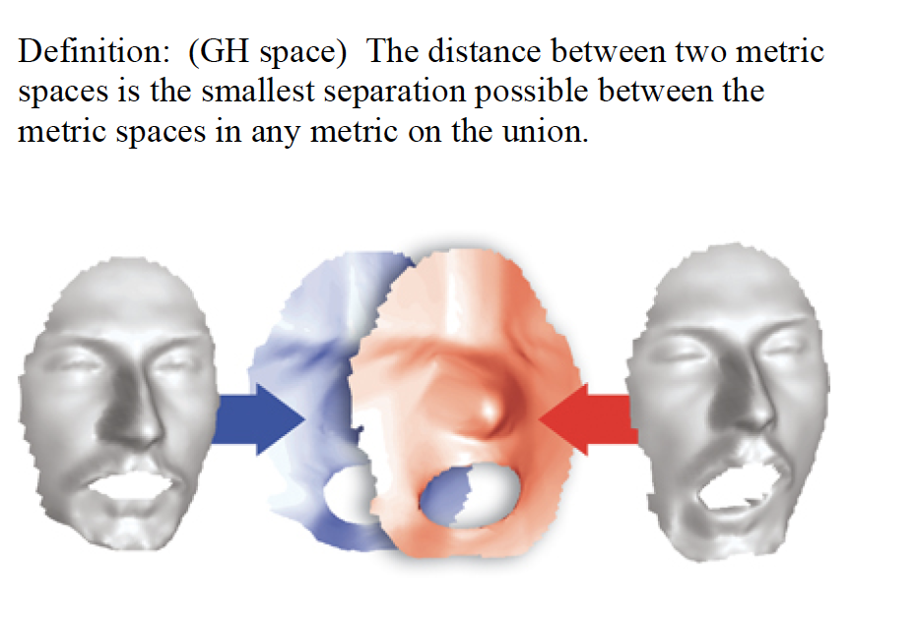
Gromov-Hausdorff Space

Slide 38
Cheeger’s theorem is part of a general finiteness theory for manifolds in a precompact subspace of Gromov –Hausdorff space.

Slide 39
“Using interpolation theory”
Theorem of Fefferman et al: If M is a manifold with bounded curvature and reach in Euclidean space, then one can recover the differentiable type of M from random noisy samples with high probability under appropriate conditions on the noise.
Compare: Fefferman-Klartag on Whitney approximation problem.

Slide 40
The theoretical minimum for approximation
For functions it’s equicontinuity: the relation between ε and δ in the definition of continuity.
(This determines how closely the data points should be spaced to determine the function up to a given error).

Slide 41
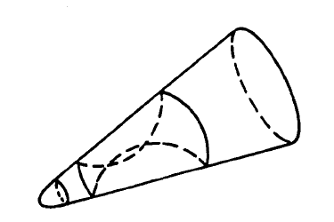
The theoretical minimum for approximation
For manifolds it’s LC(ρ).

Slide 42
The theoretical minimum for approximation
For manifolds it’s LC(ρ). B(r) should be nullhomotopic within B(ρ(r))
(This determines how closely the data points should be spaced to determine the function up to a given error).
This builds in a multiscale structure. And we will see that it makes a difference....

Slide 43
How close do manifolds have to get to ensure homotopy equivalence?
Connect the dots!
So we want roughly ρρρρρρ (d times)(δ) < ε. Where [0,ε] is the domain of definition of ρ.

Slide 44
Sometimes homotopy equivalence implies homeomorphism
Recall the Poincare conjecture (Smale’s theorem if n>4): If M^{n} is homtopy equivalent to S^{n}, then M is homeomorphic to S^{n}
Theorem (Ferry). For every M^{n} there is an ε>0 so that any f: M →N^{n} (N a connected manifold) with point inverses of diameter < ε is homotopic to a homeomorphism.

Slide 45
An impossibility theorem
Theorem (Dranishnikov-Ferry-Weinberger) There are precompact subsets of Gromov-Hausdorff space such that for every ε, among the LC(ρ) manifolds there are non-homeommorphic manifolds within ε of one another.
There are examples among manifolds diffeomorphic to homogeneous manifolds, but not among aspherical manifolds.

Slide 46
Last Remarks
This theorem seems like a new obstruction to general multiscale geometric analysis:
Question: When can one do genuinely multiscale geometric reconstructions?
It also seems to provide a place where the geometry-analysis parallelism breaks down.

Slide 47
THANK YOU!

